Slide 1
CARDIOVASCULAR RISK PREDICTION
IBM HACKATHON PROJECT
Presented By:Edunet Foundation
Faculty name :Deepneel Majumdar
Student Name_1 :Badal Kumar Sahoo
Student Name_2 :Lawrence Linkan Sahoo
College Name & Department : VSSUT(Electronics & TC)

Slide 2
OUTLINE
Problem Statement
Technology used
Wow factor
End users
Result
Conclusion
Git-hub Link
Future scope
IBM Certifications

Slide 3
Problem Statement
The dataset comes from an ongoing study about heart health in Framingham, Massachusetts.
The goal is to predict whether a person is at risk of developing coronary heart disease (CHD) over the next 10 years.
It includes over 4,000 patient records, each with 15 different attributes that provide key health information.
These attributes cover a wide range of factors, from personal demographics to lifestyle habits and medical history, all of which could influence heart disease risk.

Slide 4
Technology used
Python
Jupiter notebook

Slide 5
IBM cloud services used
Watsonx.ai Studio
Watsonx.ai Runtime
Cloud object storage-PC
AI/Machine Learning

Slide 6
Wow factors
AI-Driven Risk Predictions: We’ll use IBM Watson Studio to create machine learning models that can accurately predict cardiovascular risk, bringing the power of AI to healthcare.
Real-Time Monitoring: An interactive dashboard will allow users to track their heart health in real-time, offering personalized risk insights.
Clear Visuals & Transparency: IBM’s tools will help us create easy-to-understand visualizations and explain how the AI makes its predictions, making everything more transparent and user-friendly.
Scalable & Secure: By using IBM Cloud, we ensure the project can grow with more data, all while keeping sensitive information secure and compliant with privacy regulations.

Slide 7
End users
Healthcare Providers: Doctors and cardiologists using predictions to assess and treat patients' heart disease risk.
Patients: Individuals seeking personalized insights and recommendations for managing their cardiovascular health.
Health Insurance Companies: Insurers utilizing risk predictions to offer tailored plans and interventions.
Researchers & Public Health Organizations: Researchers leveraging the data to improve public health strategies and prevention efforts.

Slide 8
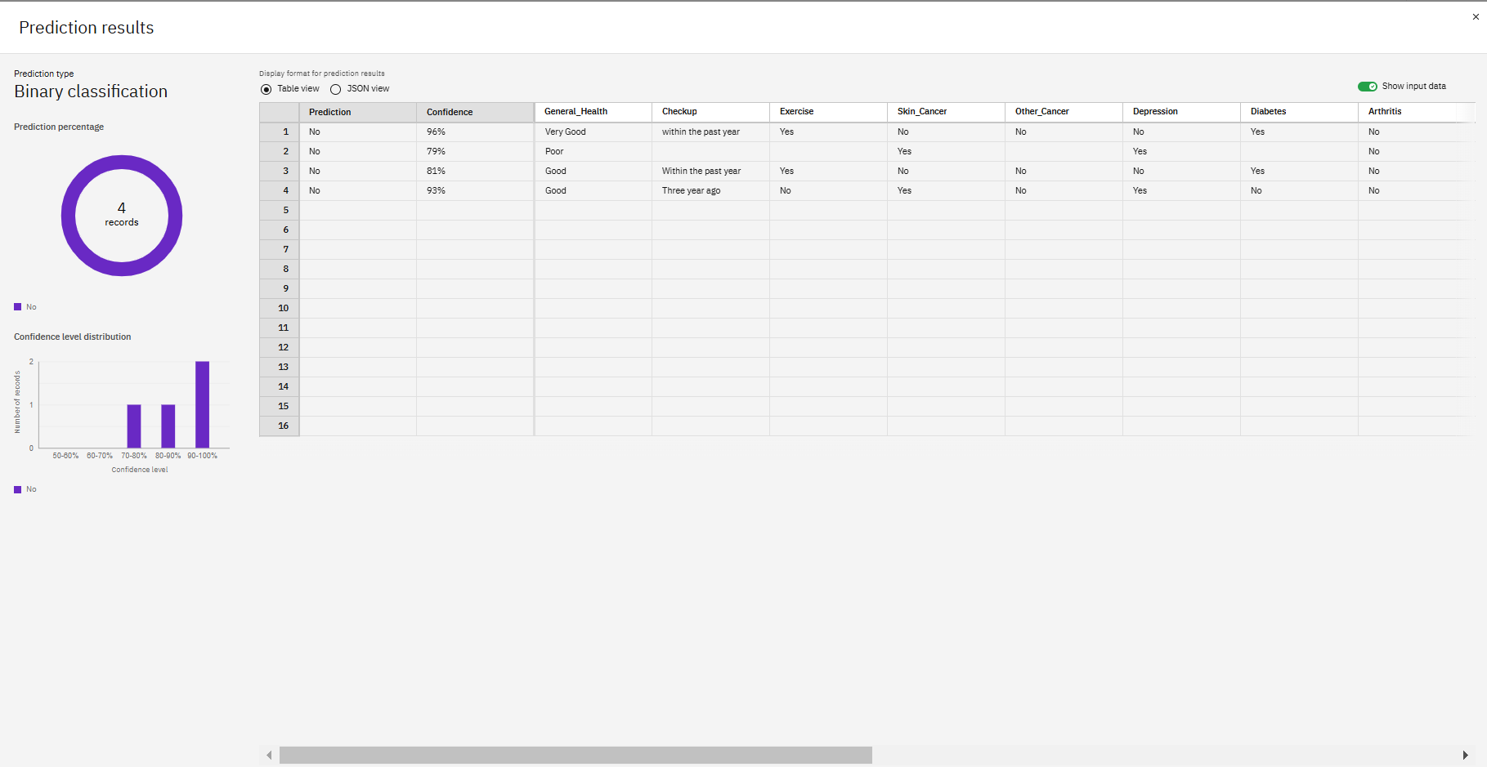
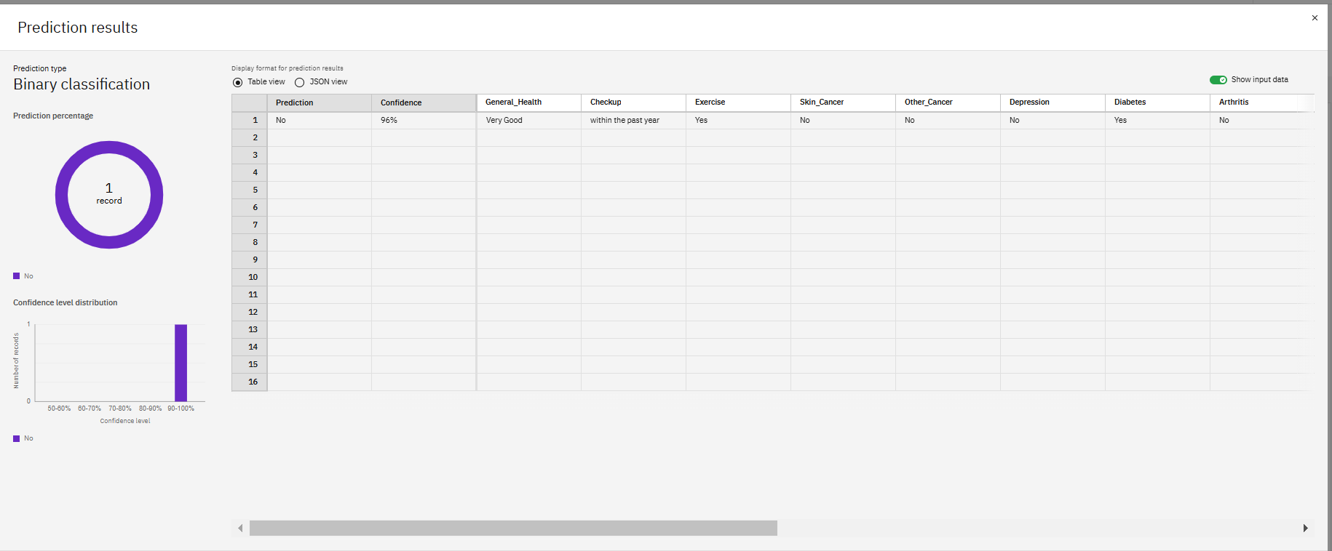
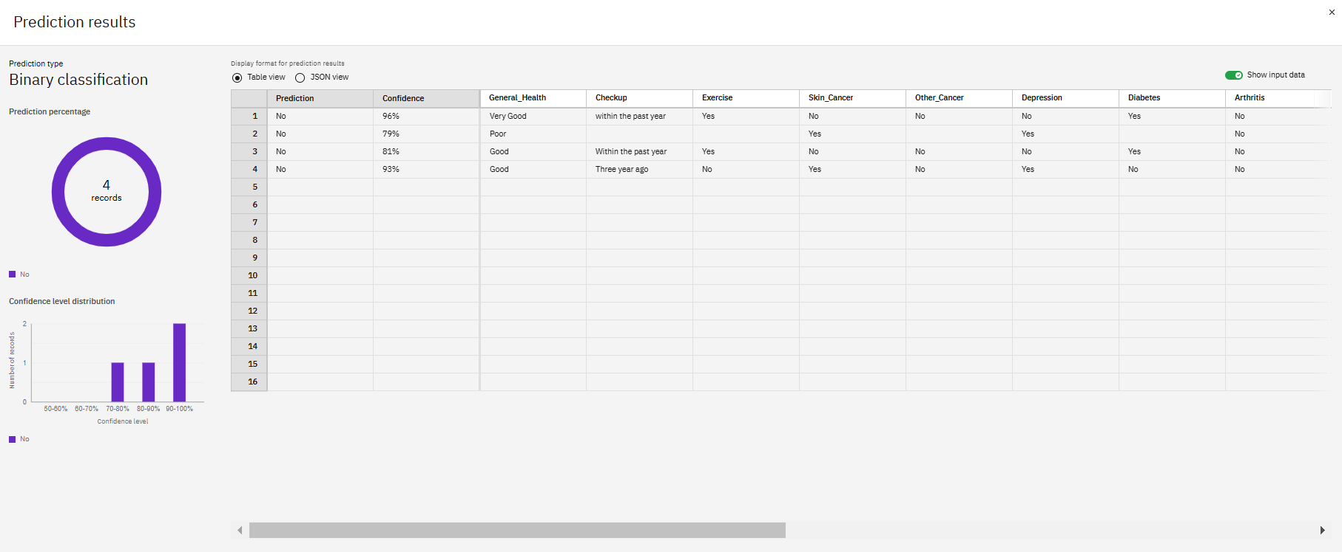
Results

Slide 9
Conclusion
The project demonstrates how IBM Cloud's advanced data analytics and machine learning tools can enhance cardiovascular risk prediction, providing more accurate, timely assessments. This technology helps healthcare professionals make informed decisions, ultimately improving patient outcomes and preventative care strategies.

Slide 10
GitHub Link
https://github.com/Lawrence-37/Cardiovascular-Risk-Prediction

Slide 11
Future scope
Real-time Monitoring with Wearables: Using data from wearable devices to track heart health in real time, allowing for early detection and personalized insights.-
Personalized Risk Predictions: Tailoring risk assessments based on an individual’s genetics, lifestyle, and environment, making healthcare more personal and effective.-
AI for Early Action: Using AI to not just predict cardiovascular risk but also recommend actionable steps to prevent issues before they arise.-
Global Health Collaboration: Connecting with health systems worldwide to share data and insights, improving cardiovascular care on a global scale.

Slide 12
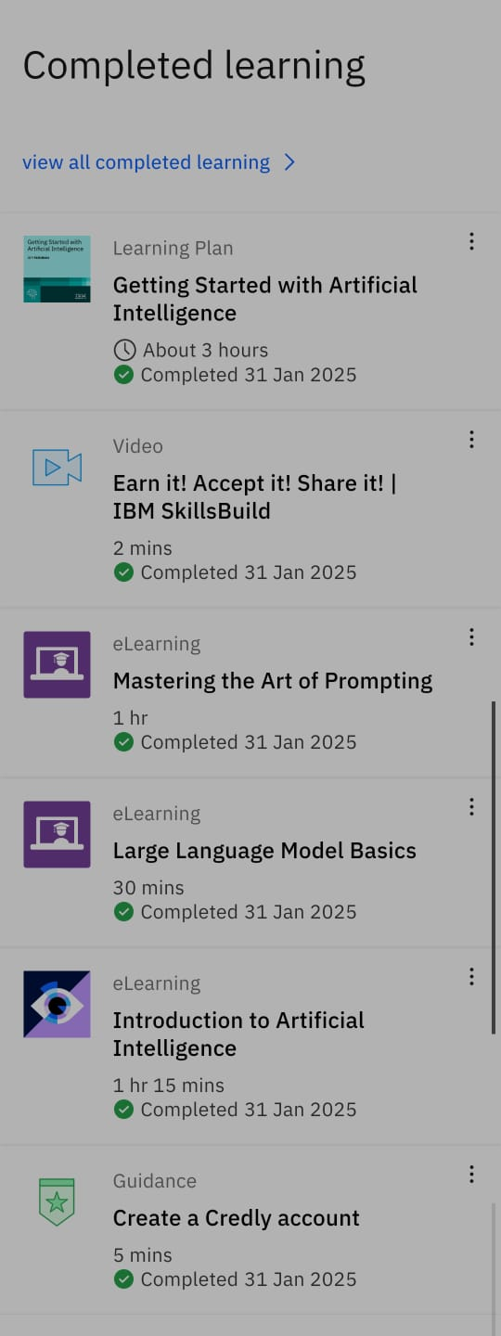
IBM Certifications
1)Badal Kumar Sahoo
2)Lawrence Linkan Sahoo

Slide 13
THANK YOU

